Slide 1
Stock Data Analysis And Prediction
Fall 2023 CSGY-6513-D, Big Data
Ujjwal Narain Asthana (una207),
Vivek Nayak (vgn2004),
Prasanna Sai Puvvada (pp2689)

Slide 2
Github Code:
FrontEnd: https://github.com/pprasannasai/StockPredictionDashboards
BackEnd: https://github.com/unasthana/StockAnalysisAndPrediction

Slide 3
Project Statement
In the contemporary landscape of financial markets, the ability to make timely and informed
investment decisions is a critical challenge. The global stock market, characterized by its
dynamic nature, is influenced by an intricate web of factors, such as economic conditions,
political events, corporate earnings, market sentiment and so on. These variables, along with
the inherent volatility of stock prices, make it exceptionally challenging for a potential investor
to make investment decisions in the stock market.

Slide 4
Objective
● Develop dashboards for visualizing, grouping and analyzing stocks based on different metrics.
● Implement predictive models to predict future stock prices.
● Help users diversify their portfolio by clustering stocks into different categories based on different degrees of risk and return.

Slide 5
Data Source
The dataset employed for this project is titled "S&P 500 Stock Data."
It encompasses the daily trading information of all the stocks included in the S&P 500 Index Fund, with data entries spanning from February 2013 to February 2018.
1) Size: Approximately 58MB when uncompressed.
2) Number of Rows: Approximately 619,000.
3) Number of Columns: 7.
4) Dataset link: https://www.kaggle.com/datasets/camnugent/sandp500/
The columns are:
Open Price
Close Price
High Price
Low Price
Volume of shares traded
Stock Ticker
Date

Slide 6
Technology - Model Architecture and Storage
Machine Learning (K-Means Clustering)
For clustering stocks together according to varying degrees of Market Risk and Stock Returns.
Deep Learning (Tensorflow)
For predicting future stock prices, an LSTM based Neural Network is trained for each stock.
Tensorflow offers HDF5 model saves that support weight compression, thereby leaving a smaller memory footprint.
MongoDB
LSTM model’s HDF5 files were around 0.5 MB each (500 of them).
Small file sizes implies we do not need to use object-storage solutions like S3.
250 MB total size, fit well within M0 limit of 500 MB.
GridFS
GridFS allows us to stream model files from MongoDB
Metadata can be used to tag the ticker name, which helps in quick search

Slide 7
Technology - Backend
Django
Django Admin dashboard, serializers and ORM layer are useful for quick setup.
For complex data wrangling, pandas was used; integrates well with other Python code.
Python backend plays well with other python libraries required for this project, like tensorflow.
PostgreSQL (prod), SQLite (dev)
On local, SQLite ensures quick development and easy data sanity checking on the admin dashboard.
In production, Heroku integrates well with PostgreSQL (plug-in) and does not play well with SQLite.
PostgreSQL is more performant and scalable than SQLite.
Heroku
Free tier allows apps with size upto 500 MB.
Used ‘tensorflow-cpu’ instead of ‘tensorflow’ to stay within memory bounds.

Slide 8
Technology - Frontend
Streamlit
Rapid Prototyping: Allows for quick development and iteration.
Ease of Use: Intuitive syntax and low learning curve, ideal for data scientists
Interactive Visualizations: Seamless integration with libraries like Matplotlib and Plotly for data representation.

Slide 9
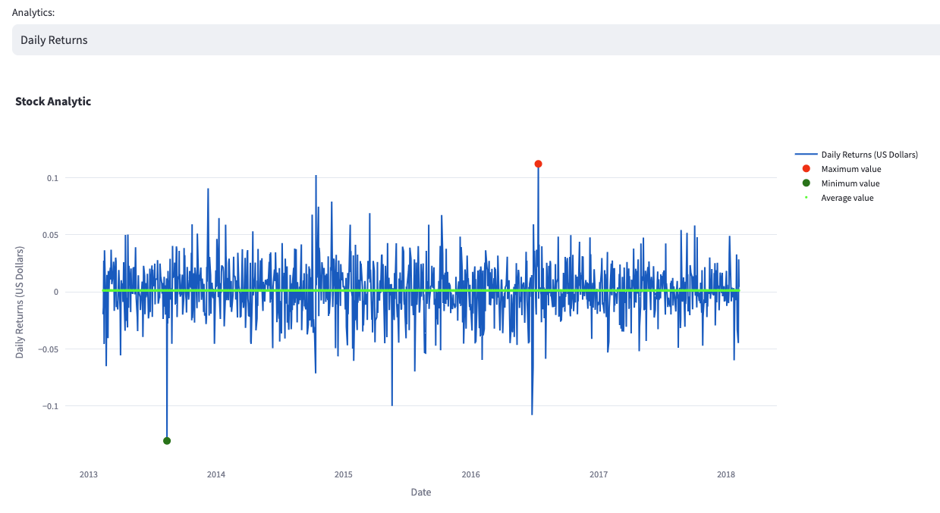
Analysis
Daily Returns of given Stock:
Find Daily Returns for each Stock with respect to close price and for a particular time frame.
Daily Returns is the percentage change in the close price of a stock in successive periods.
It helps model performance comparison, volatility measurement and so on.

Slide 10
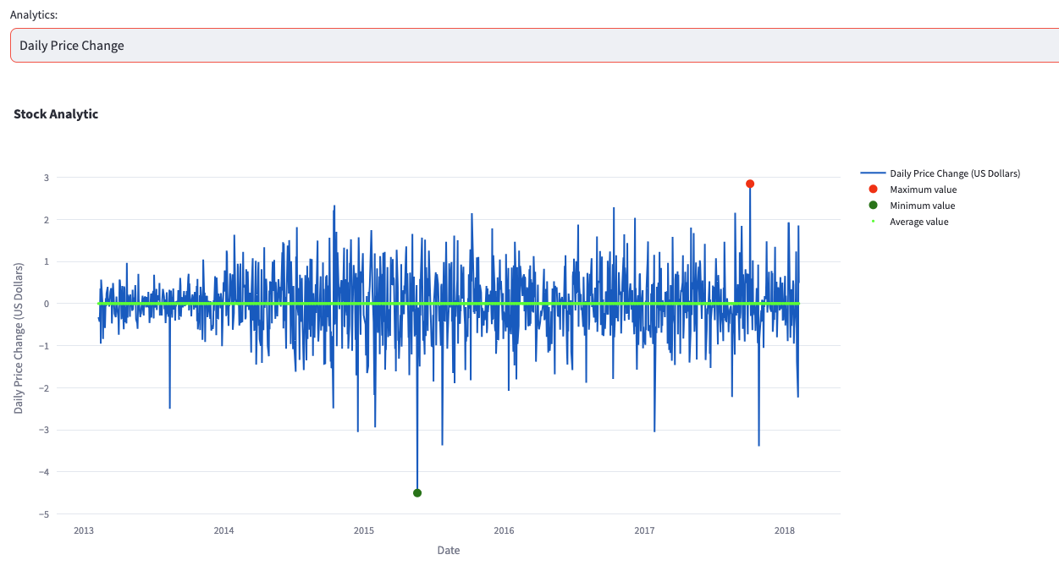
Analysis
Daily Price Change of given Stock:
Find daily price change for each Stock for a particular time frame.
Daily Price Change = Close Price - Open Price
It helps model market direction, volatility measurement among other things.

Slide 11
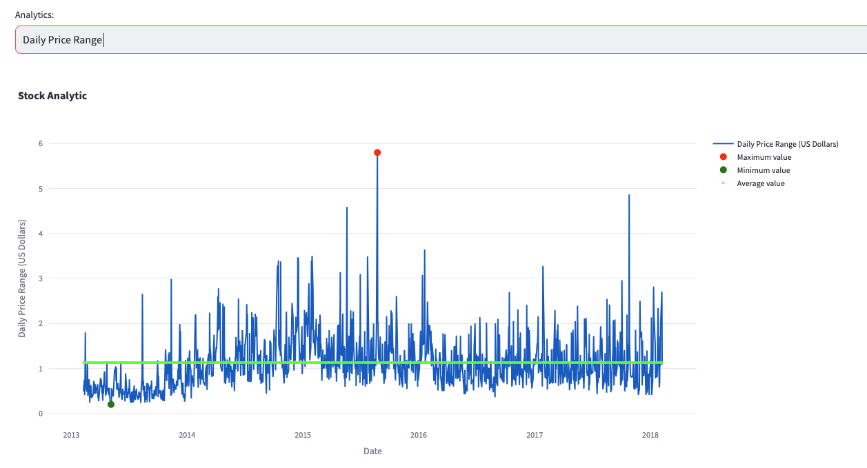
Analysis
Daily Price Range of given Stock:
Find daily price range for each Stock for a particular time frame.
Daily Price Range = High Price - Low Price
Again, this comes in very handy in volatility analysis.

Slide 12
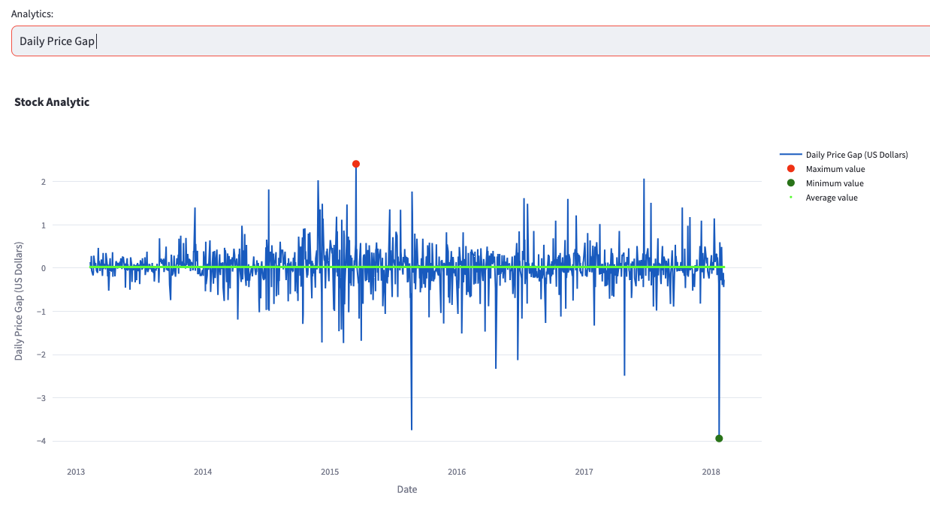
Analysis
Daily Price Gap Analysis of given Stock:
Find Daily Price Gap for each Stock for a particular time frame.
Daily Price Gap = Open Price - Previous Day’s Close Price
This helps in finding price momentum, overnight market sentiment, trend confirmation and so on.

Slide 13
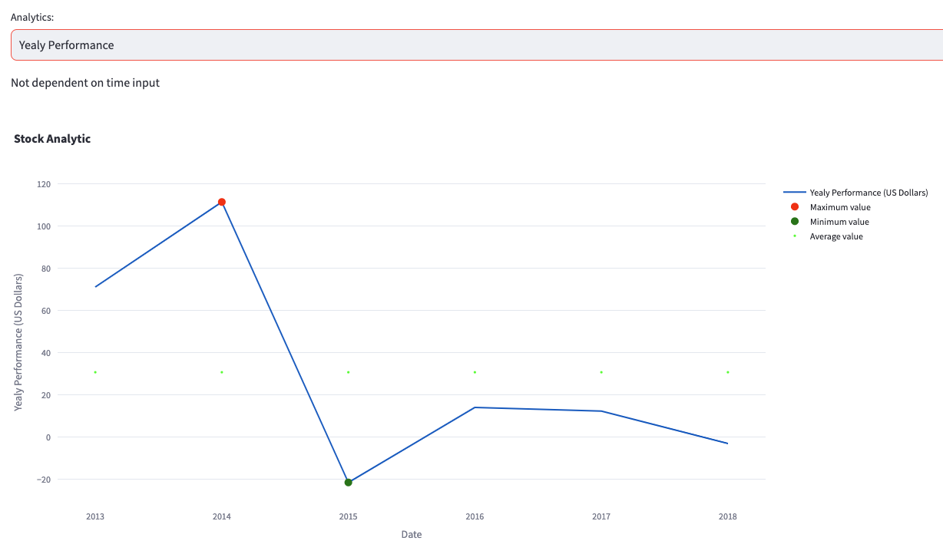
Analysis
Yearly Performance Analysis of given Stock:
Find yearly Performance for each Stock.
Yearly Performance = Percentage Change in close price between the start and end of the year.
Good metric to find investment returns, Performance comparison, etc.

Slide 14
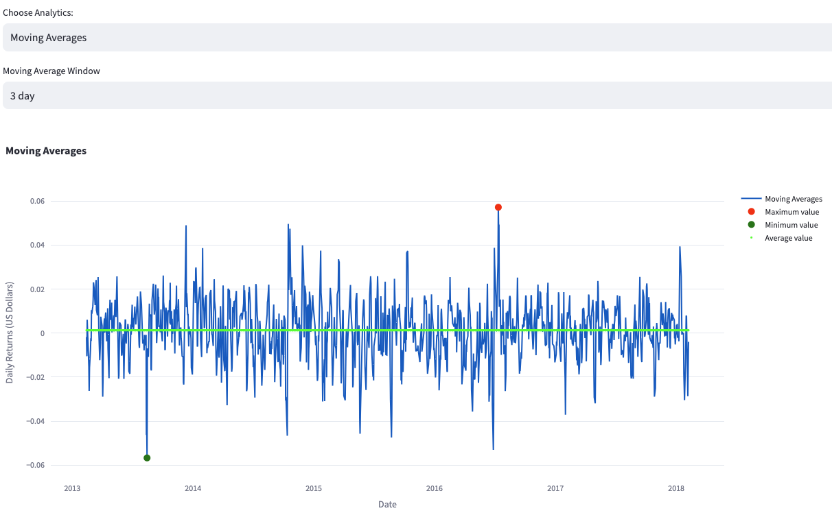
Analysis
Moving Averages of given Analytic of a given Stock:
Based on the analytics mentioned before what are moving averages of different stocks for a particular window of time.
Very useful in smoothing out day-to-day volatile changes in different analytic measurements.
Makes the trend emerge out in a more clear way.

Slide 15
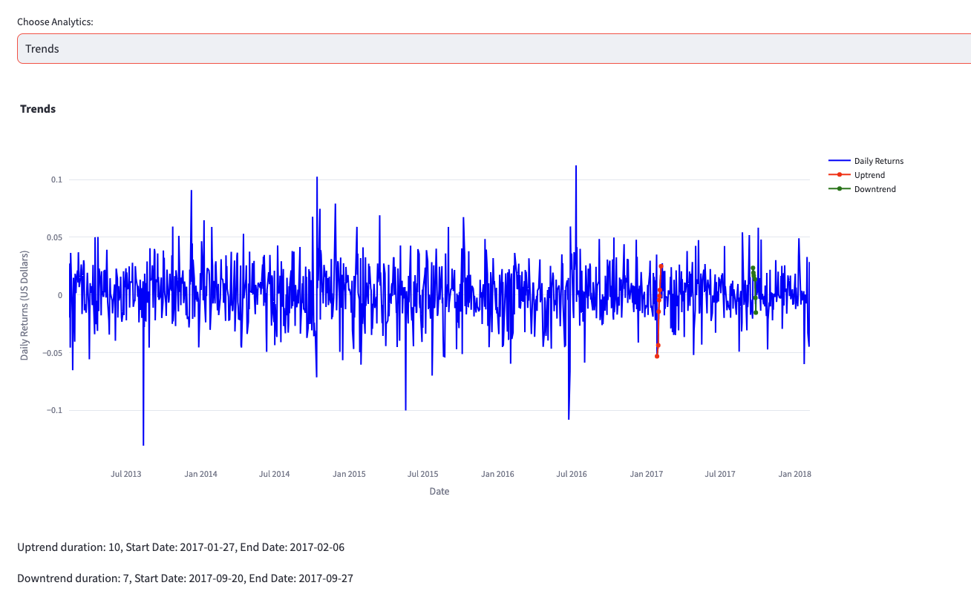
Analysis
Trend Analysis of given Stock:
When was the longest continuous uptrend or downtrend and the duration of that trend in different analytics mentioned above?
Choose the analytic and moving average window to get the trends.

Slide 16
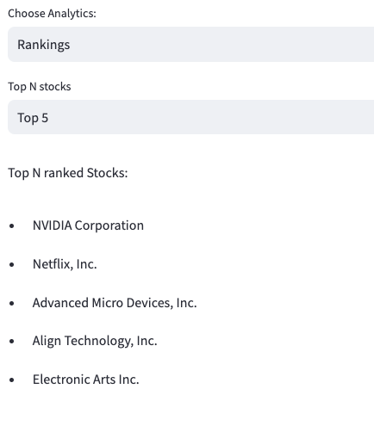
Analysis
Rank Analysis of given Stock:
What are the rankings of stocks based on different analytics, such as Daily Returns, Price Change Statistics, Volume Analysis, Performance, Price Range Statistics and Gap Analysis?
Choose the analytic to get the rankings.

Slide 17
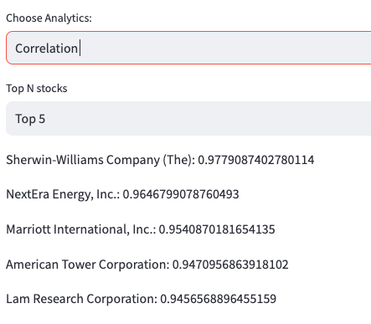
Analysis
Correlation Analysis of given Stock:
How are stocks correlated with each other?

Slide 18
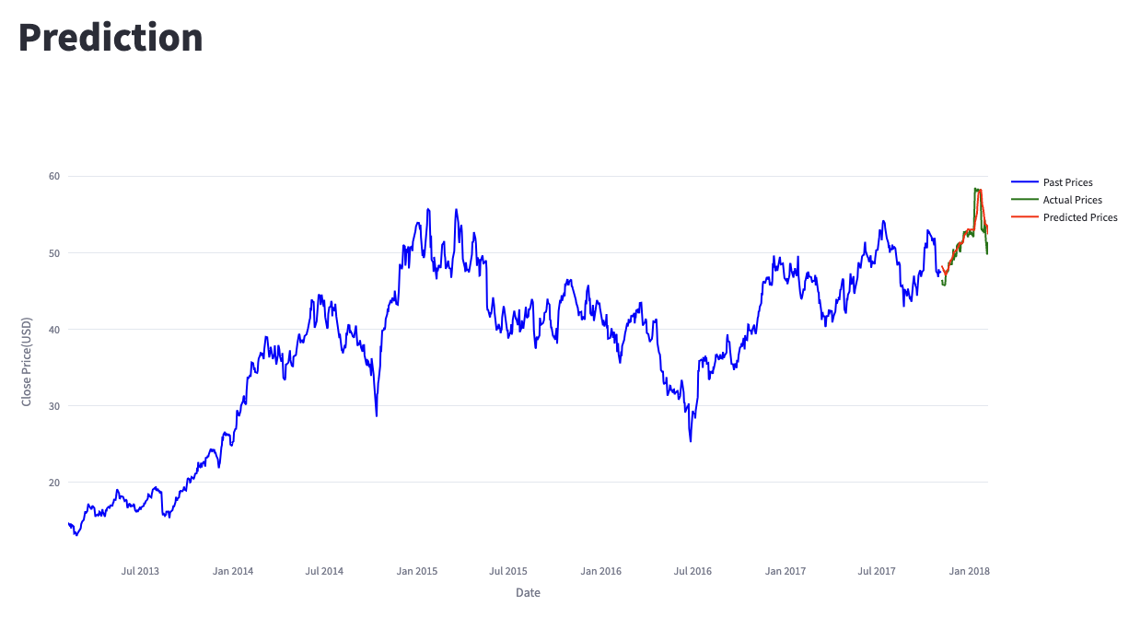
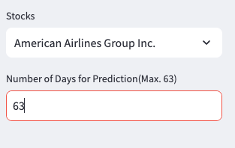
Stock Prediction
This dashboard would answer the following questions:
● What is the predicted price for the selected stock for the next ‘N’ days?
● Visualize the price movement in order to help the customer to make an informed trading
decision.
● LSTM Model Training for stock price prediction.

Slide 19
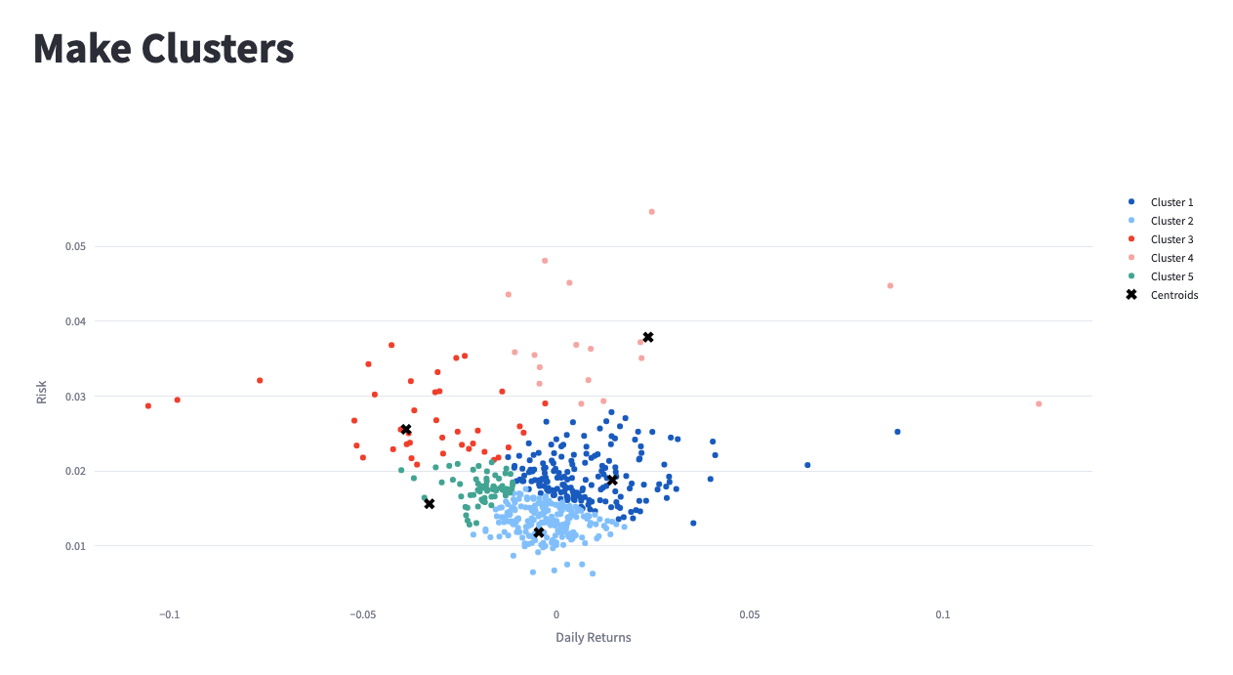
Cluster Prediction
Stocks are grouped into 5 clusters based on Market Risk and Stock Return.
Helps user diversify his portfolio.
Cluster 1 represents some stocks which have high returns and low risk. (The Ideal Ones!)
Cluster 3 represents some stocks negative returns and high risk. (The Bad Ones!)

Slide 20
Conclusion
Lessons Learned
Achieved a sophisticated level of analysis, by integrating various advanced statistical and machine learning techniques, each selected for its particular strength in handling the complexities of stock market data.
Understanding Financial Markets: It's crucial to have a basic understanding of how financial markets work, including factors that affect stock prices.
Use of Advanced Analytics and Machine Learning: Predicting stock prices often involves complex algorithms and machine learning models.
User Experience and Interface Design: The application's interface should be user-friendly. Presenting complex stock data in a simple, understandable format is a key challenge.

Slide 21
Future Work
Making front-end UI more intuitive for the end user.
Using state-of-the-art Risk calculation methods for clustering stocks.
Implement cluster number optimization.
Implementing more efficient caches for different analytics.
Design a Reinforcement Learning based Portfolio Optimizer.
Implement Sector based analytics.

Slide 22
Demo

Slide 23
Thank you!
Q&A

